Slide 1
Supporting Immigrant Students & Families Training for Educators
This presentation was adapted from Education Austin’s series of Know Your Rights trainings for educators.
We are grateful to Education Austin and Montserrat Garibay for sharing this important resource and for their continued commitment in supporting immigrant students and families
Notes:
Allyson will thank everyone for coming and introduce presenters and Dr. Bedell
Dr. Bedell- speak for a few minutes
Legal speak for a few minutes

Slide 2
Session Outcomes
You will know:
How and why undocumented immigrants enter the U.S. and their constitutional rights
How KCPS is supporting students and families
How teachers and schools can support students and families
How families and students can create a rapid response plan
Understand Deferred Action for Childhood Arrivals
What online informational and instructional resources are available to families and teachers
Notes:
Allyson
Introduce lee and Jessica

Slide 3
There are 4.1 million U.S.-born children with at least one parent or family member who is undocumented.
Guide for Educators and School Support Staff
Notes:
Allyson

Slide 4
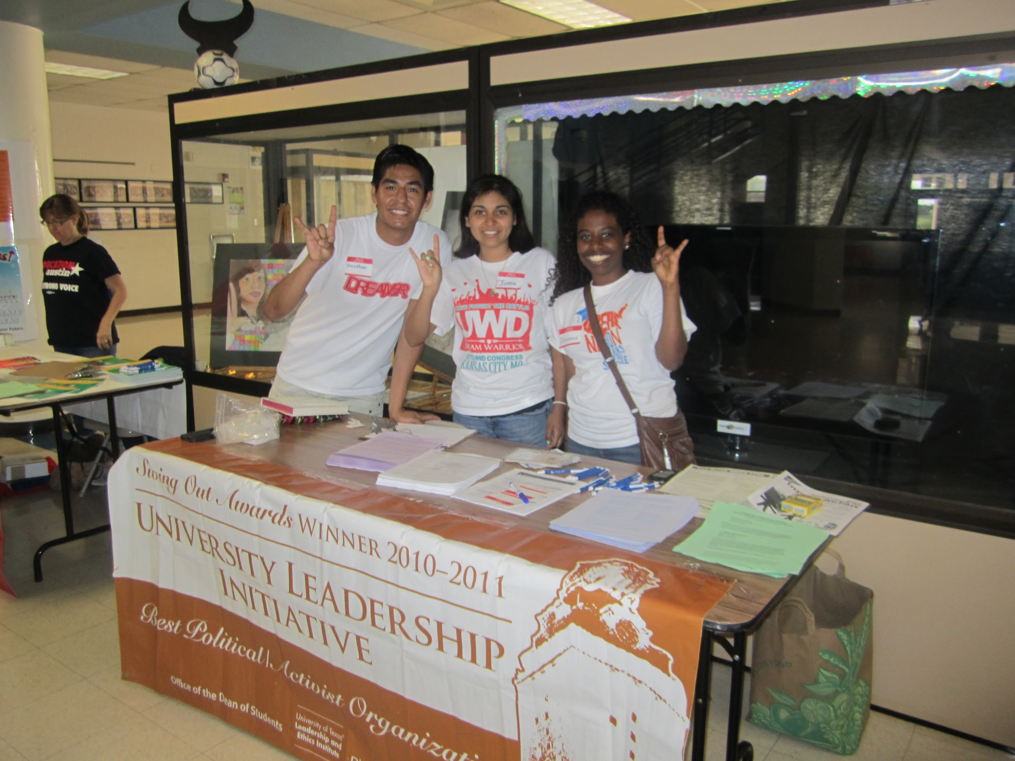
Undocumented Students
An undocumented student is an aspiring citizen who came to the U.S. without legal documentation or who has overstayed his or her visa.
They are racially and ethnically diverse, from all over the world and are part of the 11.5 million undocumented immigrants in the U.S.
They often don’t know that they are undocumented until they begin the college application process.
They don’t qualify for federal grants or loans.
May also be known as DREAMERS
Notes:
Allyson
Where are undocumented immigrants from?
DACA- 750,000 have received DACA status

Slide 5
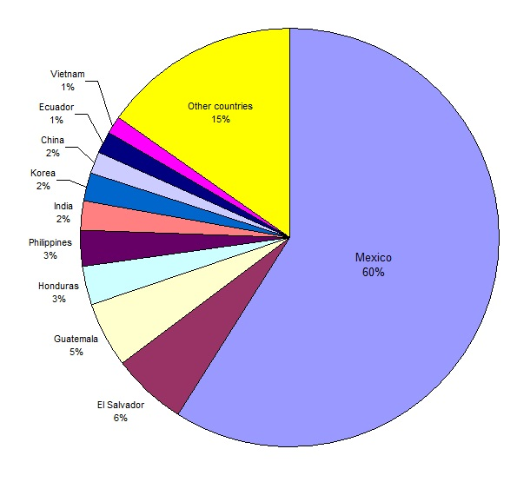
Where do undocumented immigrants come from?
Notes:
Allyson
https://www.nytimes.com/interactive/2017/03/06/us/politics/undocumented-illegal-immigrants.html?_r=1

Slide 6
How Illegal Immigrants Arrive in the US
Source: “Here’s the Reality About Illegal Immigrants to the United States.” The New York Times, March 6, 2017 By VIVIAN YEE, KENAN DAVIS and JUGAL K. PATEL
Notes:
Allyson

Slide 7
Unaccompanied Youth
Children who have no lawful immigration status in the U.S.
Are under the age of 18
May or may not have parent or legal guardian in the U.S. available to provide care and physical custody
Since 2014, more than 100,000 children primarily from Central America, have sought refuge in the U.S., to flee violence in their home countries
Notes:
Allyson
More than 102,000 unaccompanied children from Central America and Mexico were apprehended by U.S. Customs and Border Protection at the U.S.-Mexico border from October 2013 to August 2015.1 While most of the Mexican children are quickly returned to Mexico, children from noncontiguous countries, under U.S. law, are transferred to the Office of Refugee Resettlement (ORR) within the U.S. Department of Health and Human Services to be processed and simultaneously placed in removal proceedings. The vast majority of these children are released by ORR into the custody of a parent, relative, or friend in the United States while they wait for their cases to progress through the immigration court system.2 - See more at: http://www.aft.org/ae/summer2016/pierce#sthash.YUdOfJuW.dpuf
The Office of Refugee Resettlement also offers some short-term services. Before child migrants are released to sponsors, they are housed in ORR-funded shelters where they receive classroom education, mental and medical health services, help in case management, and access to social opportunities and recreational facilities.11 They also receive family reunification services to facilitate their safe and timely release to family members or other sponsors. In less than 5 percent of cases, and generally for children who are victims of trafficking or have disabilities,12 ORR funds a home study (which includes background checks and interviews) to make sure the potential sponsor is able to ensure the child’s safety and well-being.13 However, most sponsors receive little screening. - See more at: http://www.aft.org/ae/summer2016/pierce#sthash.YUdOfJuW.dpuf

Slide 8
All children are welcome in our nation’s public schools.

Slide 9
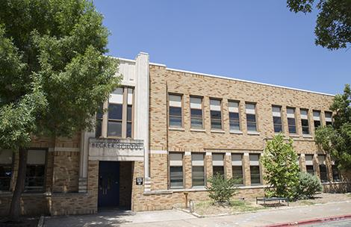
The law has established the common public benefit of our schools serving all children.
Plyler vs. Doe: A Landmark Supreme Court Case
Under federal law, ALL children, regardless of their citizenship or immigration status, are entitled to a K-12 education.
Schools districts that either prohibit or discourage children from enrolling in schools or taking advantage of school services, such as college counseling, because they or their parents are undocumented immigrants may be in violation of federal law.
Notes:
Legal

Slide 10
Public schools are required to follow federal law regarding the privacy of student data
Under the Family Educational Rights and Privacy Act (FERPA), schools are prohibited from providing information from a student’s file to federal immigration agents. The school, however, may release ‘directory’ information, such as a student’s place of birth, and information that is requested under a judicial order or lawfully issued subpoena.
For more on FERPA
Notes:
Legal

Slide 11
Sensitive Locations
Under Obama sensitive locations have included:
Schools, colleges, universities and other institutions of learning.
Hospitals
Churches, synagogues, mosques and other institutions of worship
Funerals, weddings, and other public religious ceremonies
Public demonstrations, such as marches, rallies or parade
There are big questions about whether current Administration will follow this memo or seek to rescind or ignore it.
Notes:
Allyson or Jessica?
Under Obama, schools, churches, places of worship were protected but that is not necessarily the case now..

Slide 12
Steps KCPS Has Taken
Notes:
Allyson and/or Legal

Slide 13
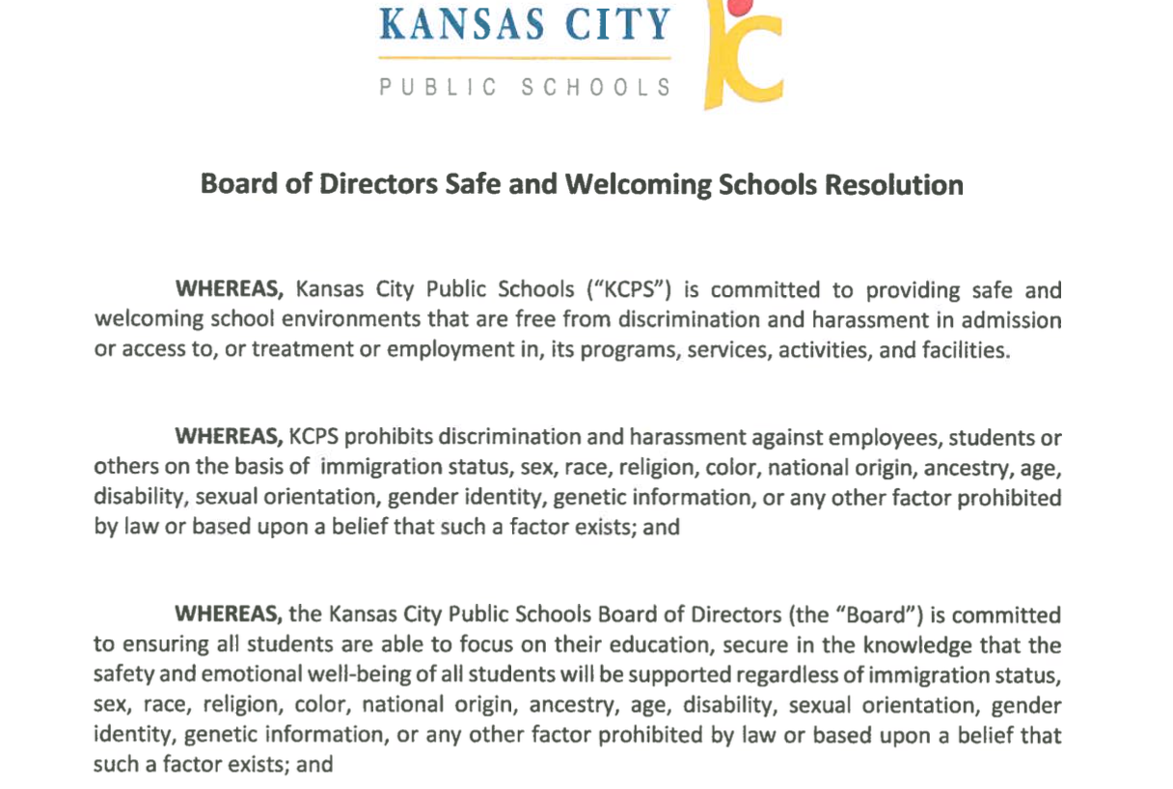
What has KCPS done to support families?
KCPS Safe and Welcoming Schools Resolution
KCPS Safe and Welcoming Schools
Office of Student Interventions protocol for support
Multiple Know Your Rights sessions for families and communities with the Mexican Consulate and area immigration attorneys
Maintain a list of resources, such as social workers, pro-bono lawyers and local immigration advocates
Notes:
Allyson

Slide 14
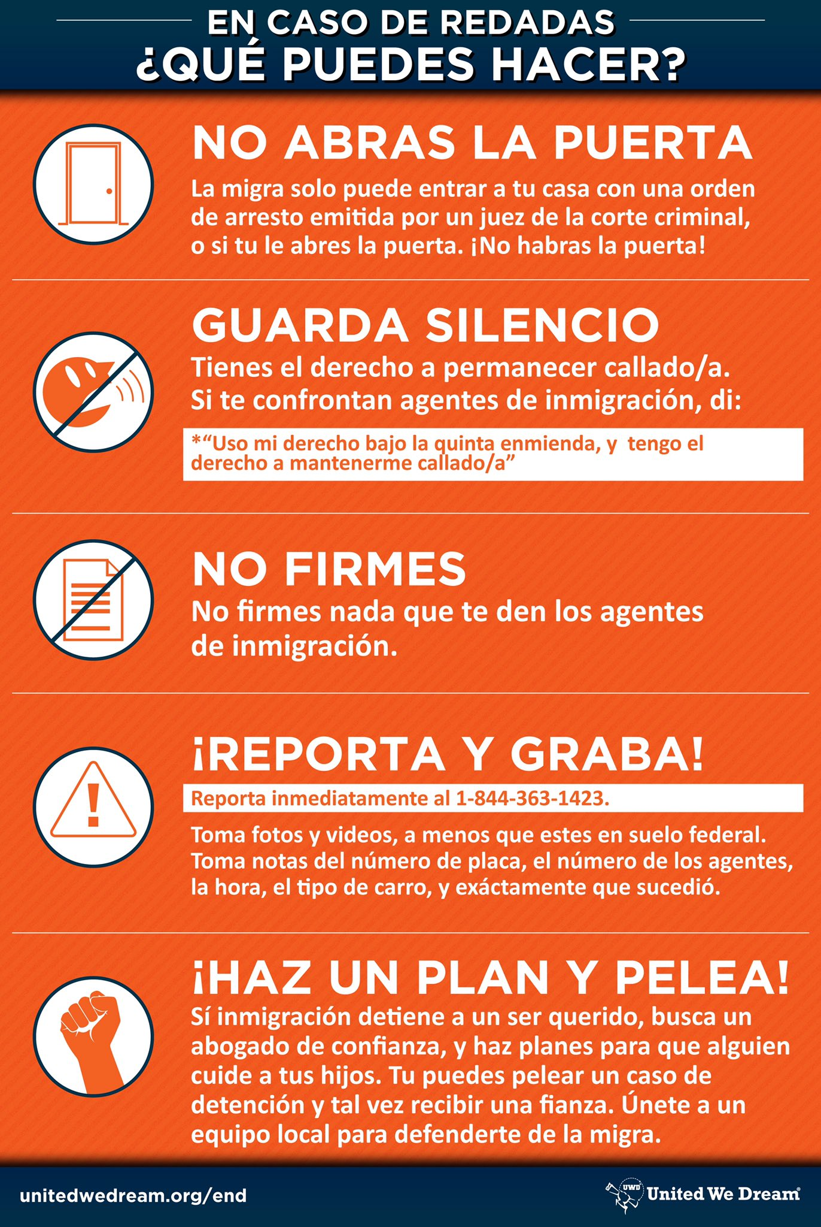
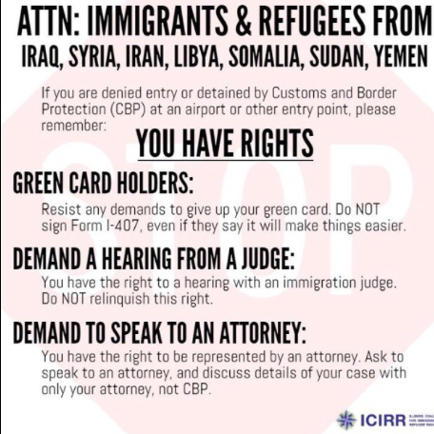
What can you or your school do?
Be informed as to what undocumented families rights are
Post this information or hand out to families
Help families be aware of the steps they can take to be proactive
Notes:
Allyson

Slide 15
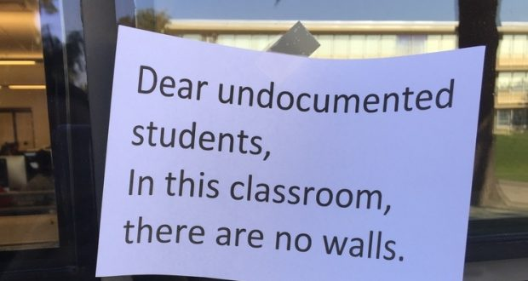
What Can You or Your School Do?
Provide school counseling or referrals to students who have had a family member detained
Provide a safe place for students to wait at school if a parent or sibling has been detained
Provide a list of resources, such as social workers, pro-bono lawyers and local immigration advocates
Identify someone at your school who can serve as an immigration resources coordinator and advocate
Notes:
Allyson

Slide 16
Being Prepared
How families and students can create a rapid response plan.
Notes:
Lee/Jessica

Slide 17
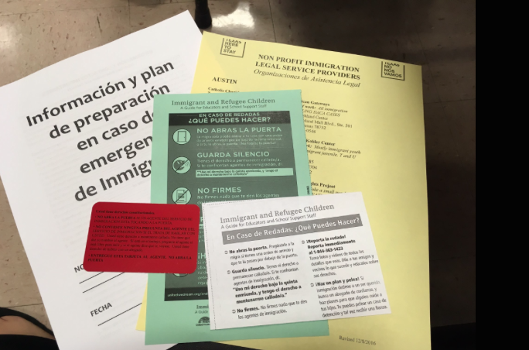
Identify a reputable legal aid organization
Keep the organization’s or person’s contact information with you at all times
Notes:
Lee/Jessica
Like the American Immigration Lawyers Association and Catholic Charities

Slide 18
Identify at least two willing caregivers
1. Write down their complete contact information
2. Ask children to memorize caregivers’ contact information
3. Update school emergency contact forms and designate approved adults for student pick up
Notes:
Lee/Jessica

Slide 19
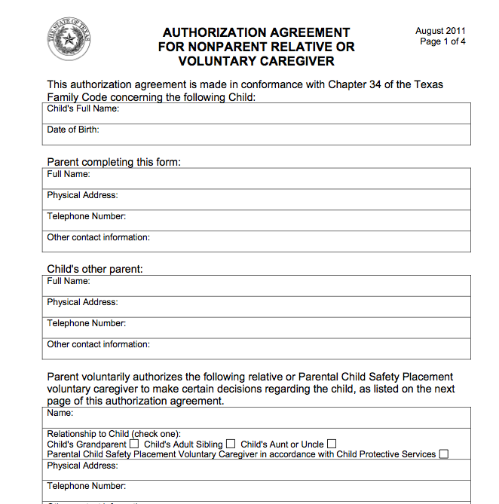
Make a plan for caregivers
sample
Parents may be considering establishing a power of attorney for a designated caregiver for their children under the age of 18
Family law varies by state. Parents considering this option would be advised to connect with family law services through local legal aid organizations.
Notes:
Lee/Jessica

Slide 20
Have documents organized and ready
Documents should be accesible by children, housemates or trusted relatives in case of an emergency
Passports
ID’s
Attorney contact information
Financial records
Letters from immigration
Alien registration number
Notes:
Lee/Jessica

Slide 21
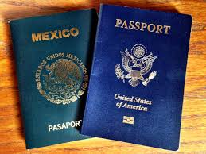
Collect important documents for children
Passports
Birth certificates
Social security cards
School and medical records
Notes:
Lee/Jessica

Slide 22
Organize your financial information
Financial records
Bank Statements
Savings accounts
Credit cards
*Save money for legal fees/bonds
Notes:
Lee/Jessica

Slide 23
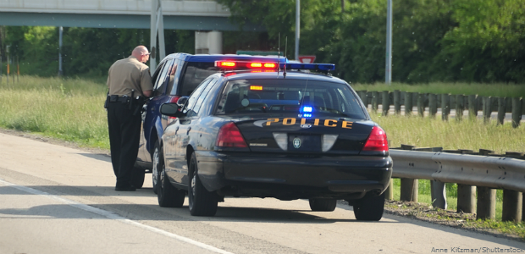
If stopped by the police
Be CALM!
Stop the car in a safe place as quickly as possible
Turn off the car
Turn on the internal light
Open the window part way
Place hands on the wheel
Notes:
Lee/Jessica

Slide 24
If stopped by the police…
Don’t carry any false documents
Don’t lie. Tell the law enforcement agents you want to remain silent.
Don’t sign any document that you don’t understand
Don’t discuss your citizenship or immigration status with anyone other than your lawyer
Notes:
Lee/Jessica

Slide 25
If you or a family member is detained
Know the phone number of a person who can call a lawyer
Immediately inform officer
If there are children or elderly family members at home
If you have a medical condition
If you need to coordinate care of children
Do not sign any documents given to you by immigration agents
Do report the raid or arrest immediately
Find an attorney and connect with local advocates
Notes:
Lee/Jessica

Slide 26
To find someone who has been detained by ICE
Use ICE’s online detainee locator to find an adult who is in immigration custody.
You can search by using the person’s Alien Registration Number and country of origin or biographical information https://www.ice.gov/contact/ero
Call Executive Office for Immigration Review’s hotline at 240-314-1500 or 800-898-7180
Notes:
Lee/Jessica

Slide 27
Understanding Roles of Law Enforcement

Slide 28
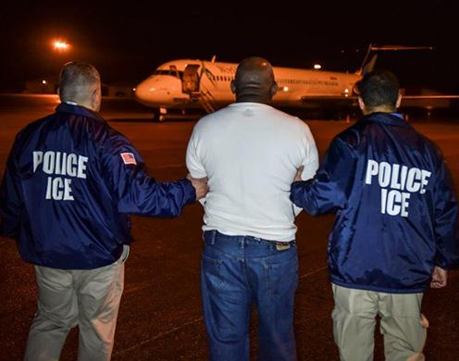
Immigration and Customs Enforcement (ICE)
Enforces federal laws
Governs border control, customs, trade and immigration
Focuses on Enforcement and Removal Operations and Homeland Security

Slide 29
General Local Police Duties
Patrol communities
Enforce traffic and parking laws
Work with other police department units as well as other local, state and federal entities
Conduct preliminary investigations at crime scenes
Pursue, search and detain suspects
Make arrests
Respond to calls for service from the community
Please note: New Administration policies are giving local police departments greater immigration enforcement powers.

Slide 30
750k Young People Hold Temporary Status that Benefits All Communities including students, educators & small business owners, etc.
Notes:
Jessica

Slide 31
About DACA
Deferred Action for Childhood Arrivals: What you need to know
Notes:
Jessica

Slide 32
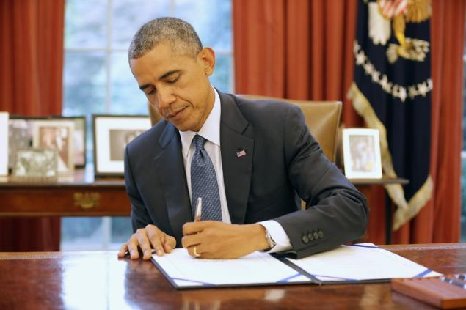
Deferred Action for Childhood Arrivals
( DACA )
Executive Action signed June 15, 2012, by President Obama
Grants undocumented youth and young adults who meet certain criteria a work permit and temporary protection from deportation.
Subject to renewal
In most states DACA recipients can apply for a driver’s license
Notes:
Jessica
DACA requirements for applicants:
Were under the age of 31 as of June 15, 2012
Came to the U.S. before the age of 16
Have lived in the U.S. continuously since June 15, 2012
Entered without inspection before June 15, 2012
Were physically present in the U.S. on June 15, 2012
Are currently attending school, have a high school degree or GED
Have not been convicted of certain crimes
Pay application fee

Slide 33
Resources & Partners
Notes:
Allyson

Slide 34
American Federation of Teachers (AFT)
AFT-Immigration/ Know Your Rights
Immigrant and Refugee Children-Guide for Educators
DACA -Guide for Educators and School Support Staff
Download Dreamer poster in different languages

Slide 35
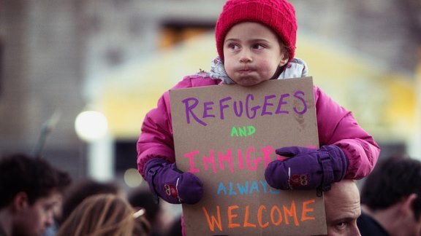
National Education Association (NEA)
5 questions educators are asking about ICE raids and supporting immigrant youth
School Bullying and Harassment Based on Actual or Perceived Race, Ethnicity, National Origin, or Immigration Status
Spanish version here
Download Welcome Dreamer Poster
/

Slide 36
United We Dream
United We Dream
Educators K-12 Toolkit
Here to Stay Posters

Slide 37
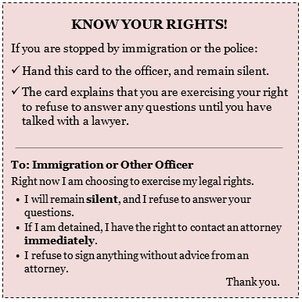
National Immigration Law Center
Know Your Rights Fact Sheet
FREQUENTLY ASKED QUESTIONS President Trump’s Executive Order Targeting Refugees and Muslims
Understanding Trump’s Executive Order Affecting Deportations and “Sanctuary” Cities

Slide 38
Mexican American Legal Defense Fund (MALDEF)
Immigrant Rights Under Trump Presidency
Derechos de Inmigrantes Bajo la Presidencia de Trump

Slide 39
Immigration Thematic Units
Immigration Lesson Plans and Resources
Pancho Rabbit and the Coyote-Lesson Plans
A rabbit, a coyote and a Texas educator help students share their immigration stories
Educator helps Students share their immigration stories
Enrique’s Journey by Sonia Nazario- Lesson Plans
Which Way Home Film
Teaching Tolerance
https://www.adl.org/education-and-resources/resources-for-educators-parents-families/lesson-plans
Notes:
Add I Learn America stories/link

Slide 40
Books about Immigration
30 Multicultural Picture Books about Immigration
Books about immigrant experience
Muslim Kids as Heroes
Books to teach students about activism
First Book

Slide 41
Other Resources
Colorin Colorado
KLRU/PBS Educational Services about how to talk about immigration issues with young children
Teaching Tolerance
Resource Guide:Supporting Undocumented Youth
Office of Refugee Resettlement directory of pro bono legal service providers

Slide 42
Area Immigration Attorneys
Immigration Professionals
5545 N. Oak Trafficway. Suite 15B
Kansas City, MO 64118
Phone: 816.221.2277
Attorney: Jesus Guereca
E-mail: jesus@immpros.org
Law Offices of Jessica Piedra
902-A Southwest Blvd.
Kansas, City, MO 64108
Phone 816.895.6363
Attorney: Jessica Piedra
Social Media: #@jpiedralaw
Garcia Immigration Law Firm, LLC
Historic Fire Station No.9
2 South 14th Street, 3rd Floor
Kansas City, Kansas 66102
Phone: 913.281.5000
E-mail: Raymond@garciaimmigrationlaw.com
Attorney: Raymond Anthony Cruz Rico
Austin & Ferguson, L.L.C.
International Immigration and Consular Services
4240 Blue Ridge Blvd.
Kansas City, MO 64133
Phone: 816.356.7110
Attorney: Catalina H. Velarde
E-mail: catalina@austinferguson.com
Sharma- Crawford Attorneys at Law
515 Avenida Cesar Chavez
Kansas City, MO
Phone: 816.994.2300
Attorney: Rekha Sharma-Crawford
Email: rekha@sharma-crawford.com
www.Sharma-Crawford.com

Slide 43
Mexican Consulate
Alfonso Navarro Bernachi, Consul
Lee Wong Medina, Deputy Consul
1617 Baltimore Ave.
Kansas City, MO 64108
816.556.0800
9 am to 5 pm
https://consulmex.sre.gob.mx/kansascity/
Notes:
Alfonso Navarro Bernachi, Consul
Lee Wong Medina, Deputy Consul
1617 Baltimore Ave, Kansas City, MO 64108
(816) 556-0800
9 am to 5 pm
https://consulmex.sre.gob.mx/kansascity/

Slide 44
Questions?

Slide 45
Thank you to…
Deputy Consul Lee Wong Medina and Jessica Piedra
Office of Student Interventions
KCPS Legal Department
KCPS Communication Department
Andrea Flinders and the AFT
And you, for attending and for your dedication to the students and families of KCPS
A note from Education Austin, Vice President for Certified employees, Education Austin, Montserrat Garibay, NBCT
A special thank you to Immigration Lawyers: Faye Kolly, Sarah Woelk and Megan Sheffield.
Thank you NEA and AFT for supporting our social justice work.
And a special thank you to the educator and community activists who are working hard every day to ensure safe and welcoming schools where every student has the opportunity to learn.
Disclaimer
The material presented here should not be relied on as legal advice. Immigration matters are complex, depend on individual facts, and may necessitate assistance from an immigration lawyer. To find a low-cost or pro bono immigration attorney in your area, go to https://www.adminrelief.org/legalhelp/.

