Slide 1
Reopening School for the 2020-2021 School Year
Department of School Leadership

Slide 2
How will KCPS re-envision education for our students?

Slide 3
KCPS Core Values
Student learning will remain a priority and will not be compromised in either of our academic options
The Safety of students and staff will be foundational in all key decisions
Notes:
Each content tested takes about an hour to complete.
Four hours of testing
Second assessment should be a little quicker because students will pick up where they left off. Their Level has been set.

Slide 4
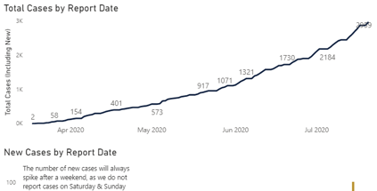
COVID-19 In Kansas City

Slide 5
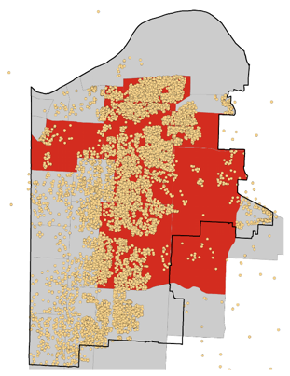
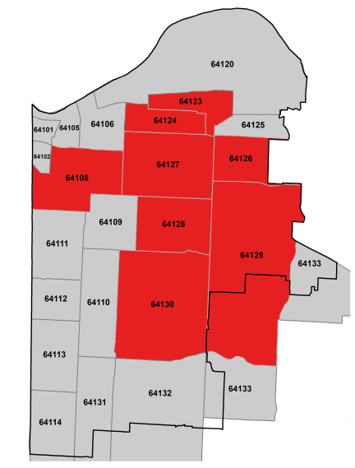
COVID-19 In the Kansas City Urban Core
Zip Code | Crude Cases Per 100,000 | KCPS District
64108 | 948.84
64109 | 487.20
64110 | 296.93
64114 | 245.85
64123 | 2515.66
64124 | 3350.27
64126 | 1512.19
64127 | 1358.61
64128 | 887.60
64129 | 588.37
64130 | 555.11
64131 | 309.61
64132 | 377.94
64133 | 471.84
Definition of Crude Cases: Number of COVID19 cases, normalized to the population of the ZIP code

Slide 6
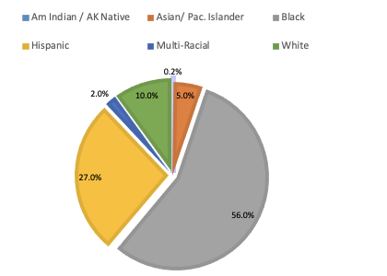
Student Demographics

Slide 7
“Project Smooth School Start”
Task Force
Academics : Learning Models and Professional Development
School Leadership: School Systems and Procedures
Operations: Transportation, Nutrition
Communications: Community Engagement
Budget and Finance: Revenue and Expenditures
Student Support: Trauma-Informed Care, Student Health, Safety & Security
Virtual Learning: KCPS Virtual Academy
Human Resources: Staffing, Recruiting, and Employee Relations
Legal: Board Policy and Research/Accountability Protocols and Procedures
Notes:
Each content tested takes about an hour to complete.
Four hours of testing
Second assessment should be a little quicker because students will pick up where they left off. Their Level has been set.

Slide 8
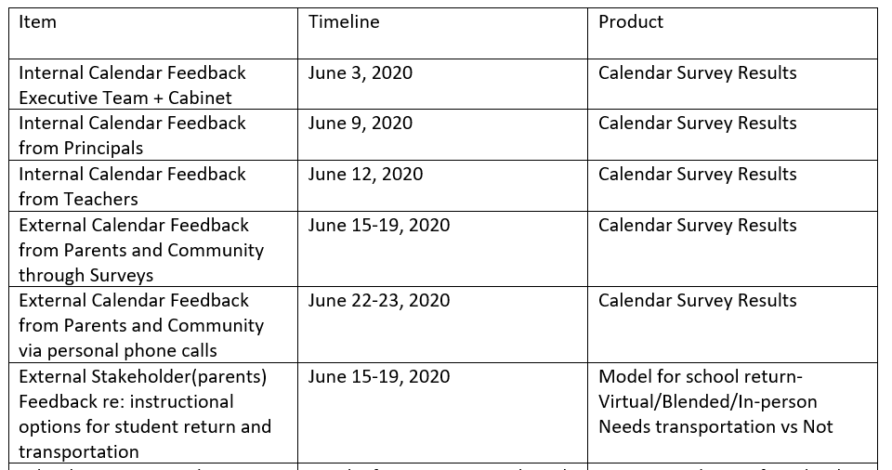
Reopening Priorities
Cabinet, Executive Team, and Principals, and School Staff Survey Results (808 responses)
Notes:
Each content tested takes about an hour to complete.
Four hours of testing
Second assessment should be a little quicker because students will pick up where they left off. Their Level has been set.

Slide 9
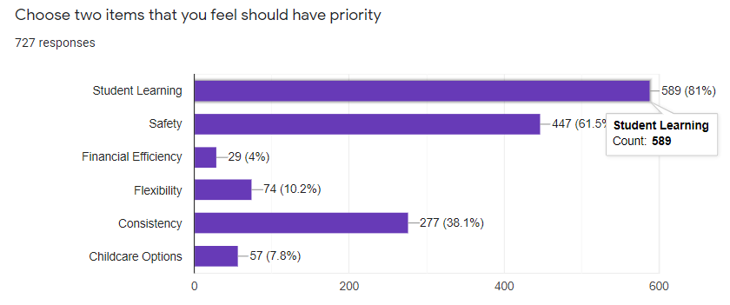
Reopening Priorities
Cabinet, Executive Team, and Principals, and School Staff Survey Results (808 responses)
Notes:
Each content tested takes about an hour to complete.
Four hours of testing
Second assessment should be a little quicker because students will pick up where they left off. Their Level has been set.

Slide 10
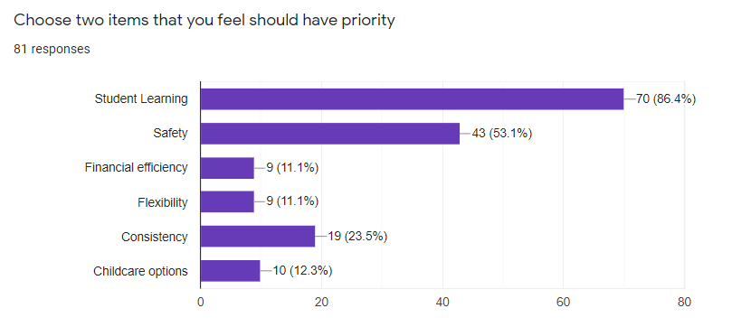
Reopening Priorities
Cabinet, Executive Team, and Principals, and School Staff Survey Results (808 responses)
Notes:
Each content tested takes about an hour to complete.
Four hours of testing
Second assessment should be a little quicker because students will pick up where they left off. Their Level has been set.

Slide 11
KCPS Reopening Plan Recommendations
Subject to change due to:
Changing health and safety guidelines (CDC)
Updated guidance from the Department of Elementary and Secondary Education
Updated guidance from state and/or local agencies
Agreements with labor unions
Current and available resources

Slide 12
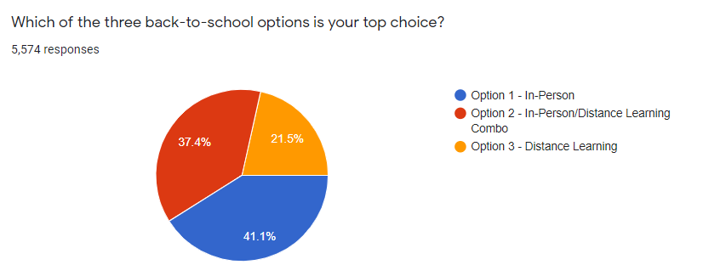
KCPS Survey Results
Parent Responses
78.5% Desire In-Person or Blended
Notes:
Each content tested takes about an hour to complete.
Four hours of testing
Second assessment should be a little quicker because students will pick up where they left off. Their Level has been set.

Slide 13
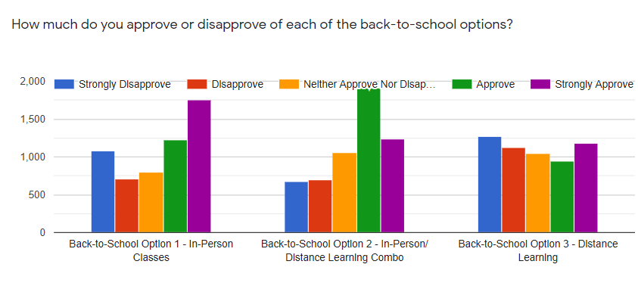
KCPS Survey Results
Notes:
Each content tested takes about an hour to complete.
Four hours of testing
Second assessment should be a little quicker because students will pick up where they left off. Their Level has been set.

Slide 14
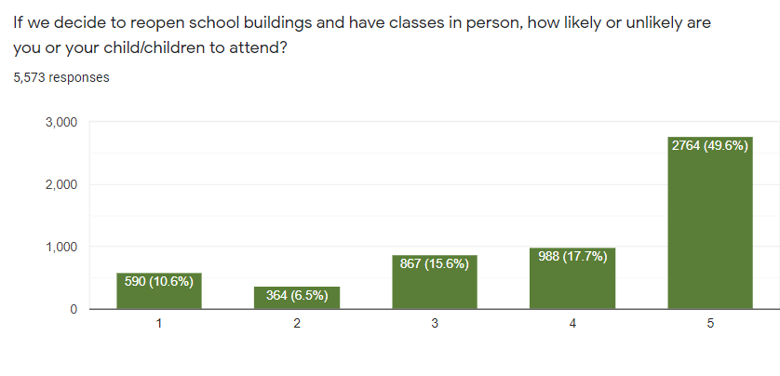
KCPS Survey Results
How do our parents feel about students returning to school (as of June 19, 2020)?

Slide 15
Our Instructional Models
100%
Distance Learning
Hybrid Learning
In-Person and Distance (A/B Schedule)
100%
In-Person
KCPS Virtual Academy

Slide 16
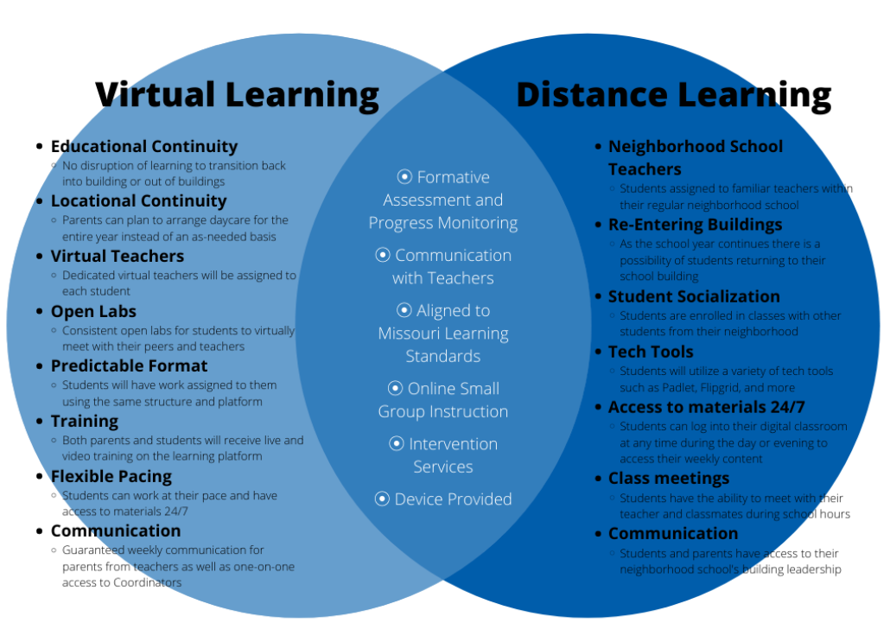
Distance Learning vs
Virtual Academy

Slide 17
KCPS Virtual Academy & Distance Learning
Grade Level | KCPS Virtual Academy Resources | Distance Learning Resources
K-5 | Edgenuity Self-paced, online curriculum Enrolled for entire semester | Adopted curriculum with digital and print resources Students responsible for participation in teacher lessons and completing assignments
6-8 | Odysseyware Self-paced, online curriculum Enrolled for entire semester | Adopted curriculum with digital and print resources Students responsible for participation in teacher lessons and completing assignments
9-12 | Odysseyware Self-paced, online curriculum Enrolled for entire semester | Adopted Curriculum with digital and print resources Students responsible for participation in teacher lessons and completing assignments

Slide 18
KCPS Recommendation for SY 2020-2021
GOAL: 100% In-Person Learning
Late Start 9/8/20
Phase I:
100% Distance Learning
Phase II:
PK-3 In-Person
Phase III:
4-8 Hybrid
Phase IV:
9-12 Hybrid
Phase V:
100% In-Person
Has Kansas City seen a consistent decline in COVID cases for 14 days? (Collaborate with KC Health Department)
Has Kansas City seen a consistent decline in COVID cases for 14 days? (Collaborate with KC Health Department)

Slide 19
What will drive a shift from one phase to the next?

Slide 20
KCPS Blended Learning
PK-3 + critical-needs students attend school Monday – Friday (Distance Learning Wednesdays) with social distancing
*Pre-K Head Start will operate on a 5-day schedule with a 10:2 ratio at school while the other 10 students participate in distance learning to be added as conditions allow
Grade 4-12 students attend school two times per week on a Blended Model
Notes:
Each content tested takes about an hour to complete.
Four hours of testing
Second assessment should be a little quicker because students will pick up where they left off. Their Level has been set.

Slide 21
Spring and Summer Distance Learning
Opportunities
Students really need 1:1 devices vs 1 per family
Grading: make sure that grading expectations are explicit
Language needs for families that speak languages other than English
Parent professional development on technology applications and meeting sites (partnership with Department of Family and Community Engagement)
More opportunities for teacher professional development on distance learning
Keep virtual meeting times consistent
Parents desire more one-on-one between the teacher and student
Parents prefer that students use one platform vs navigating through various platforms
Positives
Pre-recorded lessons allowed teachers to focus more on virtual meeting time with students
Flexibility in student pace of work
Communication and availability from teachers (teachers quickly responded to parents)
Teacher cadres encouraged collaboration around distance learning platforms
Teacher flexibility based on student needs
Parents like weekly assignments posted, allowing for students to be able to pace their work
Notes:
Each content tested takes about an hour to complete.
Four hours of testing
Second assessment should be a little quicker because students will pick up where they left off. Their Level has been set.

Slide 22
Benefits of Two-Week Delayed Start
Students will receive electronic devices (1:1)
Ongoing collection of 6,500 electronic devices from our families to be re-imaged
Teachers will be trained on the instructional models and on the revised pacing guides
Secondary teachers (ELA and math) will be trained on use of the new instructional resource tools
Teachers will be trained on the virtual co-teaching model (ELL and SPEd)
Grading procedures and protocols will be reviewed for all grade levels
Teachers will receive updated class lists
Ensure that math and reading interventionists understand their role in supporting students
Notes:
Each content tested takes about an hour to complete.
Four hours of testing
Second assessment should be a little quicker because students will pick up where they left off. Their Level has been set.

Slide 23
Benefits of Two-Week Delayed Start
Parent-Teacher Virtual Orientation Night to cover:
Attendance Procedures
Grading Processes and Protocols
Virtual Learning Schedule and Expectation
Role of the Teacher
Per grade level
Parent University to cover:
Student log-on to devices
Technology tools for class meetings
Ways to ensure virtual learning success for your student
Preliminary Testing in iReady for students
Childcare Supports
Instructional Resources
Notes:
Each content tested takes about an hour to complete.
Four hours of testing
Second assessment should be a little quicker because students will pick up where they left off. Their Level has been set.

Slide 24
How have we Prepared Schools?
School Leadership teams participated in a Virtual Leadership Institute
Teacher Professional Development: Phase 1- Technology Apps Utilized by KCPS
Principals will meet with school staff in July to review and edit tentative plan for school start
Teacher Professional Development: Phase 2- Pedagogy/Teaching Strategies
Teacher Professional Development: Phase 3- Curriculum/Content
August 10,11,12 Virtual Teacher Institute
Notes:
Each content tested takes about an hour to complete.
Four hours of testing
Second assessment should be a little quicker because students will pick up where they left off. Their Level has been set.

Slide 25
Childcare Support Options
KCPS is currently in conversation with LINC regarding providing childcare for essential workers
Meeting to be held with Principals Thursday morning, July 23, to further discuss options and school sites
KCPS is also currently in conversation with the Boys and Girls Club of Greater Kansas City to discuss a partnership for more seats for parents of essential workers
Our goal is to have a finalized plan with options by Aug. 10, 2020

Slide 26
Will Our Students be able to Participate in Athletics?
KCPS Has been in conversation with MSHAA regarding specific rules that can be applied to our student athletes, allowing them to participate in athletics
A conversation around creating a blended model for student athletes is being presented to MSHAA and DESE for approval
More information is forthcoming

Slide 27
Student Support
Special Education
Students will have case managers to ensure that their IEP goals is being adhered to
There will be regular and direct conversation with the families
Students in co-teaching classrooms will continue to have the support of co-teachers remotely;
Remote guidelines for co-teaching have been developed
Students with high minutes are considered “Critical Needs” and will receive priority when bringing students back face-to-face
English Language Learners
Families will have liaisons that provide support so that families have access to resources and technology
Our ESOL teachers will provide language support classes through Seesaw and/or Google classroom and will additionally provide co-teacher support within the classroom
Use of “Talking Points” App for communication to families in 100 different languages
Remote guidelines for co-teaching have been developed
Students who are Beginning ELL/SLIFE (Students with Limited or Interrupted Formal Education)are considered “Critical Needs” and will receive priority when bringing students back face-to-face
Notes:
Each content tested takes about an hour to complete.
Four hours of testing
Second assessment should be a little quicker because students will pick up where they left off. Their Level has been set.

Slide 28
Human Resources Frequently Asked Questions
Will staff be required to wear a mask at school/work sites?
Yes. Staff must always wear a proper facemask while in district school/work sites. KCPS will provide facemasks or you may provide your own. It is recommended that cloth masks be cleaned after use or before reusing. If you cannot wear a mask due to a medical condition or cannot remove your mask without assistance, please contact Emma Gray at egray@kcpublicschools.org or 816-418-7706, or Marilyn Overton at moverton@kcpublicschools.org or 816-418-7732 for information on accommodation/leave options which may be available to you.
When we return to school/work sites, I am concerned about returning to work in my building due to my medical condition. What should I do?
Staff members who have concerns about returning to work due to a medical condition, should consult with their physician and then connect with Human Resources/ Employee Relations to request an accommodation. Employee Relations staff members (Emma Gray at egray@kcpublicschools.org or 816-418-7706, or Marilyn Overton at moverton@kcpublicschools.org or 816-418-7732) will engage the employee in the interactive process to determine appropriate next steps for the employee.
All staff are encouraged to review the guidance from the CDC pertaining to high-risk populations at https://www.cdc.gov/coronavirus/2019-ncov/need-extra-precautions/index.html

Slide 29
Human Resources Frequently Asked Questions
If an employee suspects exposure to COVID-19 or is beginning to exhibit COVID-like symptoms, what should they do:
Working Remotely
Notify their supervisor (by email or phone)
Notify Human Resources. Your HR contacts are Emma Gray at egray@kcpublicschools.org and Marilyn Overton at moverton@kcpublicschools.org.
Consult a professional healthcare provider.
If employee is not positive for COVID-19, they will continue to work remotely.
If the employee is unable to work remotely due to positive COVID-19 test, under the Families First Coronavirus Relief Act, the employee is eligible for up to 80 hours of emergency paid leave.
Working on-site
Notify their supervisor (by email or phone)
Leave the worksite
Notify Human Resources. Your HR contacts are Emma Gray at egray@kcpublicschools.org and Marilyn Overton at moverton@kcpublicschools.org.
Consult a professional healthcare provider.
The staff member is prohibited from reporting to work for 14 calendar days and must receive documented COVID-19 clearance from a professional healthcare provider, which must be provided to Human Resources prior to return
Under the Families First Coronavirus Relief Act employees are eligible for up to 80 hours of emergency paid leave

Slide 30
Human Resources Frequently Asked Questions
This pandemic situation has me very worried. Are there mental health support resources available?
Yes. KCPS offers the Employee Assistance Program (EAP) through our provider, New Directions. Every employee is entitled to up to six complimentary counseling sessions that may also be shared with household family members. It is a free resource for staff and their household family members to speak confidentially with a care provider.
KCPS will also be providing confidential in-house support through the professionals in the Office of Student Support Services. Employees may access our professional staff by calling the COVID-Care line at 1-816-723-1355.
*COVID-Care lines have been established for all of our schools, so that families in each school has access to confidential counseling support during this time.

Slide 31
Indoor Air Quality Management
Engaged Occu-Tech, our environmental engineering vendor, to perform air quality testing at all locations
Will provide ionizers where testing indicates needed
Will modify air flow per recommendations
Will test throughout the year
Engaged control systems company to advise on air balance and fresh air flow
Will modify system software to allow for changes to airflow demands
Will increase fresh air coming into all buildings
Will increase filter grades to Merv-10 or above
Will double typical filter rotation/replacement
Will flush building air at night where needed
Engaged Occu-Tech to perform water quality testing due to closure of sites for six months
Filters: Trap and block 98% of airborne particles – recommended for superior residential and commercial use and smoke lounges

Slide 32
Cleaning & Sanitizing
Normal summer cleaning underway now (to be completed by Aug. 1)
Separated staffing to one room at a time to allow for social distancing
Surfaces will be sanitized after normal clean
Installed hand sanitizer dispensers throughout buildings and in classrooms
Changes in cleaning process during the year
Adding a Clorox 360 machine at all buildings for daily sanitizing
Providing additional waste cans to allow for classroom removal throughout the day
Increasing cafeteria cleaning rotation during the day
Increasing restroom cleaning rotation during the day
Increasing hallway touch cleaning during the day (door knobs, hand rails, etc.)
Increasing high-touch area cleaning in classrooms during the day and at night
Adding cover suits and safety glasses in the event a room is closed and cleaned for COVID-19
Adding online system to request needed cleaning and PPE supplies
May require additional staffing resources

Slide 33
Personal Protective Equipment (PPE)
PPE to be provided to Students
Two cloth masks (prepackaged)
Lanyard to keep masks from hitting surfaces
Water bottle to be filled at fountains rather than drinking from fountains
Personal bottle of hand sanitizer
Notecard on how to be safe
PPE for Staff
Two cloth masks (prepackaged)
Face Shields
Disinfecting Wipes
Extra Surgical Masks
Bottled Hand Sanitizer

Slide 34
Entering & Moving Through Buildings
Entering
Every person entering will have their temperature scanned. The district purchased digital temperature tablets that will be installed at entrances.
Those with temps over 100 degrees will not be allowed entry
Each building will have designated space to support those students who will need to return home
Moving Through and Using Buildings
Signage will be in the hallways directing traffic
Signage will be in hallways and common spaces for social distancing
Dividers will be set up where and as appropriate

Slide 35
Safety Signage

Slide 36
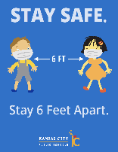
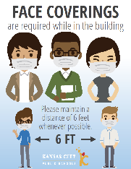
Safety Signage

Slide 37
Communications Timeline
Board of Directors meeting discussion
Finalize recommendations
Communications for staff and families – week of July 27
FAQs
Instructional models
Student health guidelines
Nutrition services guidelines
Reopening plans landing page on website
"A Day of Learning" video series
38 The Spot TV show – "KCPS Homeroom" (working title)

Slide 38
Reopening School for the 2020-2021 School Year
QUESTIONS?

